Slide 1

Predictive Models for Residential Building
Regression Analysis Final Project
Group Member:
Xiaotian Ding\ Ray Liu\ Jie Gu\ De Lu
3/14/2019
Notes:
卢德：介绍一下组员10s

Slide 2
Background Information

Slide 3
Background Information
Reason for choosing the data: combine business insight and data techniques
Data source: UCI Machine Learning Repository.
https://archive.ics.uci.edu/ml/datasets/Residential+Building+Data+Set
Reference: UCI Repository;
Kutner, M. H. (Ed.). (2005). Applied linear statistical models (5th ed). Boston: McGraw-Hill Irwin.
Notes:
1~2 卢德着重讲一下这个data set 的背景。
1、我们为什么选这个dataset: 10s. (由于我们的R太高了！所以一定要指出是UCI下载的！不是我们自己编造的。）
2、这些变量的示意：1:10s.
Page2+page3：1:30秒。

Slide 4
Dependent variable
Variable | Description
V-9 | Actual sales prices (output)
V-10 | Actual construction costs (output)

Slide 5
Important Predictor variable
Variable | Description
V-7 | Duration of construction
V-8 | Price of the unit at the beginning of the project per m2
V-16 | Private sector investment in new buildings
V-17 | Land price index for the base year
V-18 | The number of loans extended by banks in a time resolution
V-20 | The interest rate for loan in a time resolution
V-26 | CPI of housing, water, fuel & power in the base year
…… | ……

Slide 6
Process

Slide 7

Flow Chart
Data Split
Centering & Scaling
Lasso -> Model 1
Diagnostic &
Transformation
Added-variable
Lasso -> Model 2
Overfit Test &
Calculate R²
Recalculate coefficients
Without Outlier
Outlier test
Notes:
Our study process can be divided as these 6 steps. The first step is to split the database into 2 parts with ratio of 9:1 in order to do 10-fold cross validation test. Then we standardized all the variables in order to help compare coefficients.
The second step is to build our original model. We use Lasso to select the most important variables to form the Model 1. Then drew their added-variable plots to see their specific form. Add the quadratic term to Model 1, and then use lasso once again to get Model 2.
The third step is to diagnose the two models separately. We did Brown-Forsythe test and found that the errors’ variances are not constant. So we did Weighted Least Square transformation. We calculated Variance Inflation factor. Although the models have slight multicollinearity, it wouldn’t affect our prediction.
The fourth step is to test the X and Y outliers. After removing the outliers, we recalculated the coefficients of the models. Then we got the R squared and adjusted R squared. The result showed that our models did very good job even applied to the testing dataset. So we don’t need to rebuild the model from the beginning.
Thereafter, we chose the better one, Model 1 and it’s our final model.

Slide 8
Model & Diagnostic

Slide 9
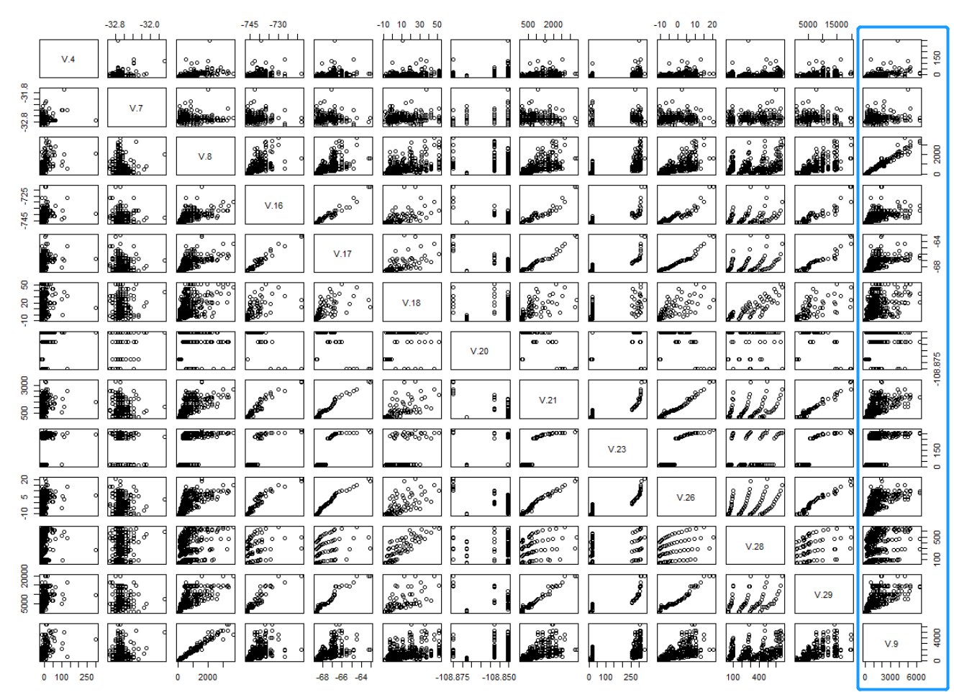
Variable Selection
Separate to Training set and Testing set by 9:1.
Scatter plot to find the general impression of relationship between independent variables and dependent variables.
Method: Lasso
Notes:
预计1:30

Slide 10
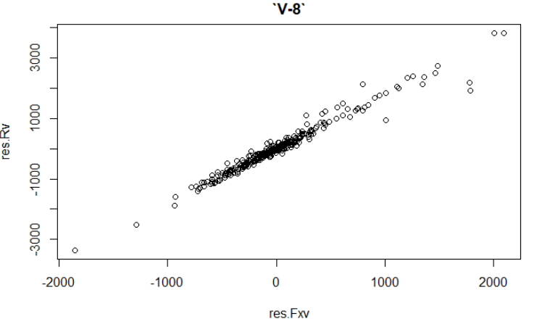
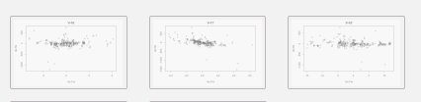

Variable Selection
Added-variable plot to decide weather the predictor variable should be squared.
Notes:
预计1:30

Slide 11


Diagnostic & Transformation-Error Variance Constant
BF-test:
Weighted Least
Square transformation:
Re BF-test:
Notes:
预计1:30

Slide 12
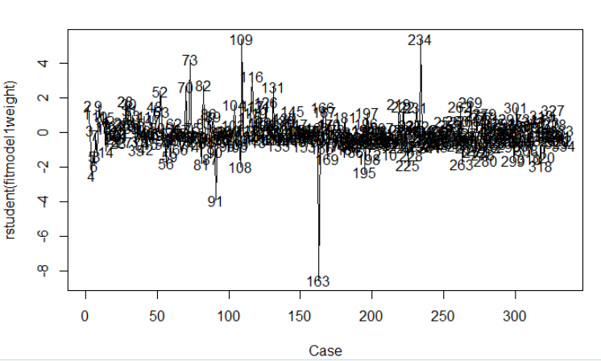
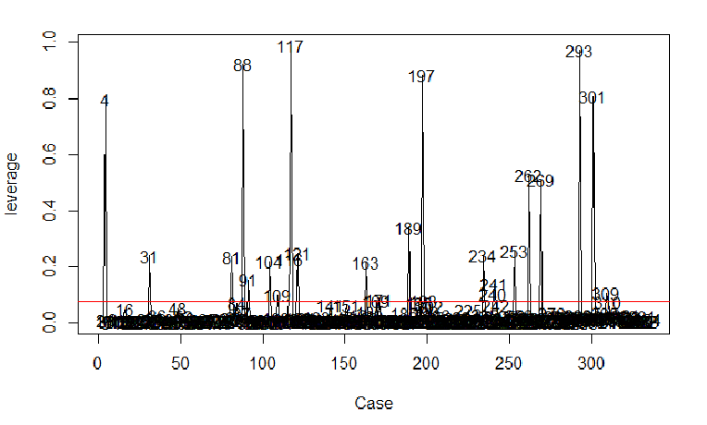
Outlier and Rebuild
Y outlier test:
studentized deleted residuals
X outlier test:
Cook’s Distance & DFFITS
Delete outliers and rebuild
R_{a}²= 99.72828%

Slide 13
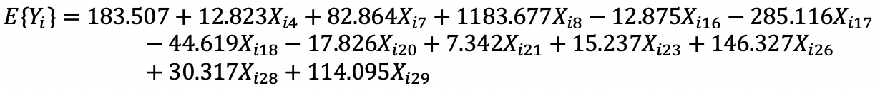
Final Model

Slide 14
VIF Test for Multicollinearity
VIF value for the predictor variables selected by Lasso:
Still have multicollinearity after Lasso selection
Notes:
The value of VIF indicates there still exist some multicollinear between variables. But it will not influence our prediction.

Slide 15
Overfit Test with Testing Data Set
Training Data
Testing Data
Training Model
Training Model
R_{a}²= 99.72828%
R_{a}²= 98.66294%
No overfitting problem
Notes:
We apply the testing data in training model and get the adj R^2 for test data. The consequence is a also very fascinating. There are no overfitting problem exist.

Slide 16
Conclusion & Improvement
The top 3 important variables:
V-8: Positive, the price of the unit at the beginning of the project.
V-17: Negative, the land price index for the base year.
V-26: Positive, the CPI of housing, water, fuel & power in the base year.
Improvement needed:
Our observations may not be big enough.
Price is time series data.
Notes:
The conclusion is we find a almost perfect regression function. And there is still have some space for improvement. All the price is time sensitive data, and we can collect more data in different time to improve our prediction.

